Slide 1

DoorDash-RoboDash Project
Developing the product
Product Manager: Jamil Abdulai
© 2019 Udacity. All rights reserved.

Slide 2
Getting Started

Slide 3
Create Project Blueprint
A product launch is not just about deploying a beautifully designed,built and thoroughly tested feature. Your company needs to be equally prepared if not more to support every possible customer interaction associated with the product (e.g landing on your company website to learn more about the new feature)
© 2019 Udacity. All rights reserved.
Notes:
[ALL PARTICIPATION]

Slide 4
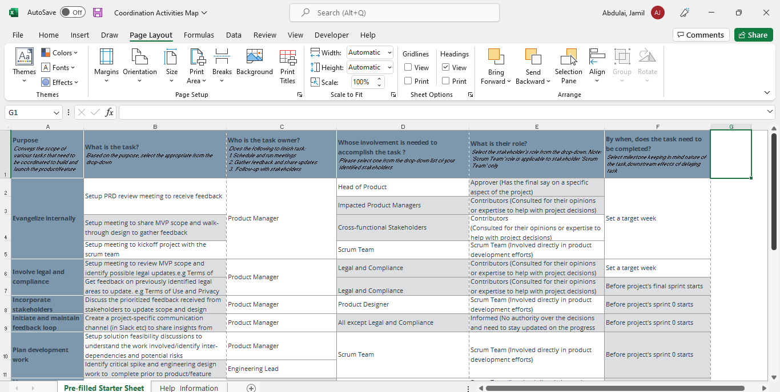
Create a coordination activities map
Share your project-specific coordination activities map here (Link here). You can also share a screenshot below.
© 2019 Udacity. All rights reserved.

Slide 5
Plan for Sprint Meeting
As a PM, it is important to stay ahead of your scrum team and be prepared for every upcoming sprint by having a target goal defined with prioritized backlog for team to start costing and breaking down the tasks
© 2019 Udacity. All rights reserved.
Notes:
[ALL PARTICIPATION]

Slide 6
Sprint Planning Meeting Preparation
Sprint Goal
Allow DoorDash members to access the website with their login and password credentials and access the new autonomous delivery option under services provided.
Sprint Backlog (list the prioritized user-stories from the product backlog)
1 | As a DoorDash user, I want to be able to access the app/webpage with my sign in credentials.
2 | As a DoorDash user, I want to have the option to access the RoboDash/Human Dash delivery services provided.
3 | As a DoorDash member, I want to be able to track my order in real-time and get updates on rerouting schedules with the RoboDash.
4 | As member of DoorDash, I want to be able to use the RoboDash to make deliver orders more than 10
5 | As a DoorDash user, I want to have access to either choose automatically either Human/RoboDash
Sprint Prioritization Logic
Have a fully functional deliverable at the end of this sprint, where the feature can be accessed to start Prioritized riskier work that involves API integration ahead since it may require multiple sprints
© 2019 Udacity. All rights reserved.

Slide 7
User Story 1
User Story | As a DoorDash user, I want to be able to access the app/webpage with my sign in credentials.
Design | Link to prototype, registration screen.
Acceptance Criteria | On the start screen, the user should have the option to sign up or sign in. They should enter their email, password and confirm their password for sign up or have the option to select the sign in with their email and password. The login process and data communication should be encrypted using Secure Socket Layer(SSL) system in combination with a secure messaging service when delicate information is within the app/website. Due to legal reasons, the terms and conditions must be accurately displayed on the login screen and be read and accepted before login is authorized. The consent must be stored in the database for future reference. Incase a user have difficulties accessing the webpage/app due to forgot email/password, they should have the option to enter a backup email/phone number to access a verification code sent which will be valid within 5 minutes. When all above steps are confirmed, the user should be able to access the dashboard page and existing services provided.
© 2019 Udacity. All rights reserved.

Slide 8
User Story 1
Assumptions | This feature should only be accessible by DoorDash members only. Guest can have access to the webpage/app but can’t complete or use the services provided unless a sign up is completed.
© 2019 Udacity. All rights reserved.

Slide 9
User Story 2
User Story | As a DoorDash member, I want to be able to track my order in real-time and get updates on rerouting schedules with the RoboDash.
Design | Link to prototype, track order screen.
Acceptance Criteria | After an order has been placed, the user should receive a confirmation of the order and when the order will be delivered in their email/SMS on their phone with a link to the order confirmation page. When the order is enroute by the RoboDash, the user should receive a notification via email/SMS on how long the order should take. The order tracking page should have GPS and map with the primary route highlighted of the order in real-time. In case of an emergency or delay, a notification should be sent to the customer in real-time od order delays or reroute options while highlighting the rerouting paths taken. In a situation where an operator must take over the robot, a notification ought to be communicated with the customer as the why those decisions were made to improve integrity and customer engagement hence increasing smooth transitioning products and services. When order is delivered successfully, the customer should be notified and given a duration to proceed to pick up order. In an event there’s a delay, communication must be rendered to the customer measures taken to speed up delivery process.
© 2019 Udacity. All rights reserved.

Slide 10
User Story 2
Assumptions | This feature should have a map attached with satellite and hybrid viewing options on map After the wait time for pick up is reached, the customer should receive a second notification for pick up within 15 minute else the product will be returned to original destination and must be hand picked from the business.
© 2019 Udacity. All rights reserved.

Slide 11
Decoding API Documentation
As a PM, you will collaborate with the engineering team and provide guidance that heavily influences their development approach. When a product requires an API integration, sometimes PM need to be “technical enough” to understand the following to refine the solution with designer and development team
what information is available via the API
how is it available
possible pricing impact
© 2019 Udacity. All rights reserved.
Notes:
[ALL PARTICIPATION]

Slide 12
DoorDash Project
Based on the API documentation how would you update your solution and design? | After a careful analysis of the documentations provided, its paramout a Distance Metrix API is integrated in the design sprint. It provides travel distance and time for a matrix of origins and destinations and consists of rows containing duration and distance values for each pair. The API returns information based on the recommended route between start and end points. One can request distance data for different travel modes, request distance data in different units such kilometers or miles and estimate travel time in traffic. The Distance Matrix exists in several forms; as a standalone API, as part of the client-side Maps JavaScript API, and lastly, for server-side use as part of the Client Libraries for Google Maps Web Services.
Based on your high-level understanding of the API documentation, are there any details that you want to discuss with engineering to refine solution and/or determine feasibility | With the information provided, I will communicate with the development team by: Showing the team, the Directions API Demo which shows you how to use the Directions API to get a set of driving directions from one location to another. Link I will also discuss the possibility of integrating this design feature with customer satisfaction in mind. I will enquire about the possibilities of using the Distance Matrix API to complete multiple deliveries by prioritizing the shortest distance to destination first without losing track of the other orders.

Slide 13
Re-prioritize Sprint Backlog
As a PM, unexpected issues and new feature requests will require you to triage them efficiently and re-prioritize the sprint backlog without impacting the roadmap deliverables significantly
© 2019 Udacity. All rights reserved.
Notes:
[ALL PARTICIPATION]

Slide 14
Issue 1: Landing Page loading too slow
Determine impact and criticality to prioritize issue | Reach out to the Data Analyst team about the landing page conversions and enquire if a higher load time culminates to lower conversions. Also, check with the Data Analyst team and verify if the bounce rate from the past 5 days have seen any fluctuations and if yes when. Furthermore, I will observe the unique visitor's metric and observe if there are any major decrease in demand and if yes how many. With a confirmation of both QA team of 38% increase in load time and Data Analyst team verifying drop in the various metrics, this issue must be immediately prioritized and fixed immediately!
Next Steps You would carry out typically using JIRA (ticketing tool), communication channel (Slack) | I will notify the impacted stakeholders of the issue and communicate with them the strategies we’re taking to curb the issue via phone calls or emails and the estimated time of completion. I will ensure I communicate with them every step of the way. I will update the JIRA board with the ticket and put it on a high priority level and immediately communicatee with the Development Team through Slack. I will furthermore update the sprint backlog in JIRA to have the issue fixed in the current sprint and classify it as a hotfix.
Would you take additional steps ? | Additional steps will be taken to accurately track this issue next time by communicating with the QA and DevTeam of new key page performance metric for the loading times of crucial pages.
© 2019 Udacity. All rights reserved.

Slide 15
Issue 2: Misaligned fields in Profile Settings
Determine impact and criticality to prioritize issue | I will reach out to the Data Analyst team about the percentage of affected Android users accessed the app/website within the past 5 days. I will check the screenshot with the QA team and further enquire if the misalignment is rendering major issues with customer satisfaction and reliability of services. I will also reach out to the customer service team about number of users complained about the anomaly. Upon analysis, the processes are functioning accurately, and the bug isn’t creating any damage to the company’s reputation hence the ticket can be prioritized to low.
Next Steps use ticketing tool (JIRA), and communication channel (Slack) | I will update the ticket in the JIRA board and set priority to low. I will communicate the impacted issue with the affected stakeholders and communicate on when the issue with be addressed. I will communicate with the QA and customer service team about the issue and has been prioritized as low.
© 2019 Udacity. All rights reserved.

Slide 16
Respond to Customer Service Manager’s Email
Determine impact and criticality to prioritize the issue (1 - Critical; 2 - High; 3 - Normal; 4 - Low) | I will enquire with the Development Team about the difference of the password reset function between the internal tool and the product. Next, I will follow up with the Customer Service team about the number of products having similar issues. Furthermore, I will check the QA team about the possibilities of users receiving an email for a change of password sent directly to them or not. The analysis depicted that the issue isn’t correlated to our product but an internal tool, nevertheless, since our reputation is at risk, it must address immediately hence classified as a high priority/critical.
Next Steps You would carry out typically using JIRA (ticketing tool), communication channel (Slack) | I will update the JIRA board of the issue and communicate with the Development team through Slack. I will notify the Product Manager overseeing the internal tool and notify the affected stakeholders of the issue and root cause with strategies to curb it.
© 2019 Udacity. All rights reserved.

Slide 17
Respond to Customer Service Manager’s Email
Sample Email Response | Hello Team, We appreciate you informing us of the specifics and gravity of the problem. We are now looking into the reason why this email to our customers was sent out late with Engineering and Develop Team. This is a crucial issue therefore we'll prioritize it. While waiting, we discovered a solution for our clients, which we wish to share with you: Customers can use the product on their own to ask for a password reset email. This email was sent out without delay after QA verification in which customers can now be directed there. That ought to assist you and the customer as we work to address the problem using our internal tool.
© 2019 Udacity. All rights reserved.

Slide 18
Handle Potentially Difficult Situations
As a PM, you will be faced with many unexpected situations where you have to make a decision or push back while managing competing priorities from stakeholders and tackling issues that could potentially affect your product launch
© 2019 Udacity. All rights reserved.
Notes:
[ALL PARTICIPATION]

Slide 19
Respond to CEO or GM’s request via email
Assessment and result | The feature isn’t fully optimized hence can’t be deployed to the staging environment yet. The demo cannot be observed on the QA interfaces/environment because its drastically changing which will impact the experience of the Development Team. The demo might not fully exhibit the major features to the stakeholders hence creating unnecessary doubts about the usability of the product.
Sample Email Response | Hello Sir/Madam, It will be wonderful to have the demo fully optimized for use in two days but unfortunately, we are within a sprint and the feature isn’t fully tested on our staging or QA environment. We don’t want to create a distaste in the eyes of the stakeholders hence the team is actively working diligently to delivered the best service possible to our clients. We will deploy the current version of the feature in as-is status for the demo to stage but please bear in mind it might cause random volatility. Please use the above credentials to login into the demo provided at the bottom of this email. Thank you and enjoy the rest of your day.
© 2019 Udacity. All rights reserved.

Slide 20
Step-in and guide the scrum team at stand up
Video Response | Share the link to your video here <insert link>
© 2019 Udacity. All rights reserved.

Slide 21
Handling Resource Constraints
List 2- 3 activities that you would carry out as a PM to unblock the scrum team immediately ? | As a PM, I will step in as the Qaand have the manual testings completed. I will communicate with the Development Team about the possibilities of someone who’s cross-trained to help in the role. I will enquire their schedule and restrategize accordingly. I will speak with the impacted PMs and seek what I can do to help them by sacrificing and strategizing for the team with the entire company in mind.
Since the QA team member is shared across multiple projects, how would you coordinate with other PMs to de-risk your project and raise appropriate visibility ? | I will set up a meeting with the affected PMs and head of the QA through an email and I will communicate with head of product afterwards by explaining and raising awareness for features at risk. I will identify tickets that can be postponed by the QA team and reprioritize tickets for sprint goals for instantaneous evaluation. I will communicate with the head of product to see if we can outsource our project to a sister company if applicable or use in-demand freelance services. Upon coordination with the other PMs, we will have to team up and step in by playing multiple roles to help each other as needed. In the event we ought to burn the midnight oil as leaders of the product, that’s what we will do to complete the projects intime.
© 2019 Udacity. All rights reserved.

Slide 22
Handling Resource Constraints
Since there is a potential risk, it is important to raise visibility amongst appropriate stakeholders | The impacted stakeholders Head of product
 | SUCCESSFUL NEGOTIATION: The Feature Go Live not at risk. We were able to strategize and prioritize the sprints to ensure goals are reached. Its paramount to notify that the shared QAs needed support due to feature prone to delay hence the essential QA tickets must be completed. FAILED NEGOTIATION: The Feature Go Live is at risk. The team couldn’t come to a shared agreements on the strategies to achieve the goal. We currently have pending tickets for the QA team which is fundamental to the success of the feature hence the launch will be postponed until further analysis is derived to come to a tangible conclusion.
© 2019 Udacity. All rights reserved.

Slide 23
How would you handle stakeholder feedback?
Feedback Assessment | Are there currently any data to about products launched with and without the notification feature? What’s the underlying reason for the inclusion of the notification feature during the launch of the MVP? An agreement was reached about the exclusion of the notification feature during the user journey hence is there any way we can revisit this feature after the product launch?
Video Response | Share the link to your video here (insert link)
© 2019 Udacity. All rights reserved.

